Slide 1
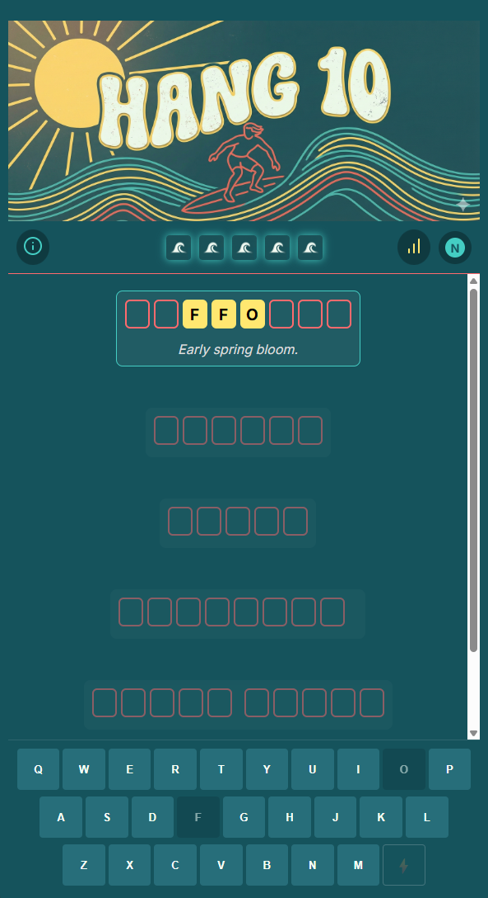
Original

Slide 2

Striped sun 1-3

Slide 3
Striped sun 4-6

Slide 4

No sun 1-3

Slide 5
No sun 4-6

Slide 6
Orange sun 1-3

Slide 7
Orange sun 4-6

